Slide 1


The Power of Smarketing

Slide 2
SALES + MARKETING =
SMARKETING.

Slide 3
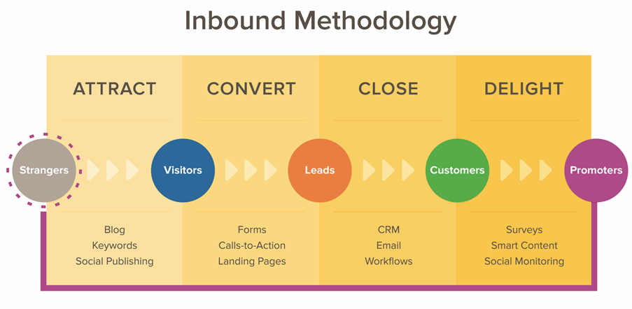

Slide 4
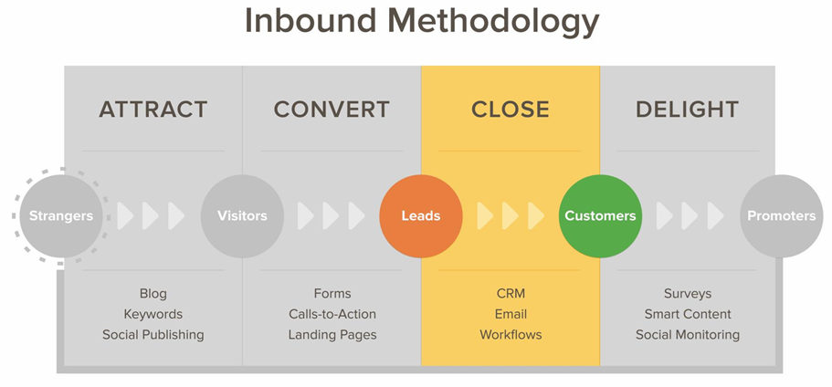

Slide 5
WHAT IS SMARKETING?
Smarketing is the process of aligning the sales and marketing teams around common goals within a business or organization, focused on improving revenue.

Slide 6
1
WHY IS SMARKETING CRITICAL TO INBOUND SUCCESS?

Slide 7
87%
of the terms sales & marketing use to describe each other are negative.
CORPORATE EXECUTIVE BOARD SURVEY: HTTP://BIT.LY/WQCZ4B

Slide 8


SALES
MARKETING
“simple-minded”
“incompetent”
“lazy”
“arts and crafts”
“academics”
“irrelevant”
CORPORATE EXECUTIVE BOARD SURVEY: HTTP://BIT.LY/WQCZ4B

Slide 9
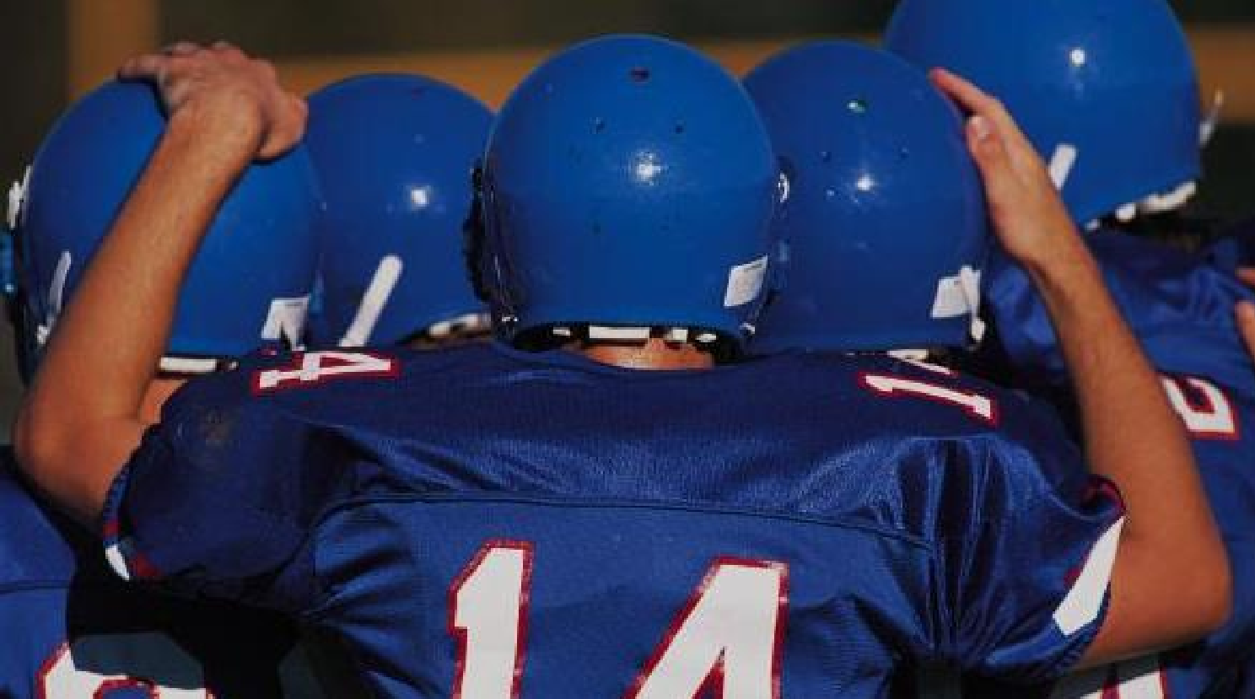
Two halves of the same team:
Team Revenue

Slide 10
20%
Companies with strong marketing & sales alignment get
annual revenue growth.
2010 STUDY BY THE ABERDEEN GROUP, HTTP://BIT.LY/ZMIJQD

Slide 11
SALES + MARKETING =
SMARKETING.

Slide 12
2
HOW DOES SMARKETING RESULT IN ALIGNMENT?

Slide 13

SMARKETING BEST PRACTICES
Both teams must have the same/interdependent organizational goals.
The marketing pipeline should be tied to sales quotas.
Visibility into each other’s goals.
Compensation based on shared marketing and sales goals.
Continual communication and education around personas.

Slide 14
SMARKETING BEST PRACTICES
Both teams must have the same/interdependent organizational goals.
The marketing pipeline should be tied to sales quotas.
Visibility into each other’s goals.
Compensation based on shared marketing and sales goals.
Continual communication and education around personas.

Slide 15

Get on the
same team.
Align both marketing and sales around the same goal.

Slide 16
SMARKETING BEST PRACTICES
Both teams must have the same/interdependent organizational goals.
The marketing pipeline should be tied to sales quotas.
Visibility into each other’s goals.
Compensation based on shared marketing and sales goals. Continual communication and education around personas.

Slide 17





The marketing pipeline should be tied to sales quotas.
Marketing Pipeline
Smarketing
Sales Quota

Slide 18
SMARKETING BEST PRACTICES
Both teams must have the same/interdependent organizational goals.
The marketing pipeline should be tied to sales quotas.
Visibility into each other’s goals.
Compensation based on shared marketing and sales goals. Continual communication and education around personas.

Slide 19

Gain visibility into each other’s goals.
Real-time information allows for real-
time adjustments and improvements.
FLICKR USER DON BURKETT

Slide 20
SMARKETING BEST PRACTICES
Both teams must have the same/interdependent organizational goals.
The marketing pipeline should be tied to sales quotas.
Visibility into each other’s goals.
Compensation based on shared marketing and sales goals.
Continual communication and education around personas.

Slide 21

Compensation around goals
Money can be a valuable lever for jumpstarting organizational alignment

Slide 22
SMARKETING BEST PRACTICES
Both teams must have the same/interdependent organizational goals.
The marketing pipeline should be tied to sales quotas.
Visibility into each other’s goals.
Compensation based on shared marketing and sales goals.
Continual communication and education around personas.

Slide 23

Alignment around personas
helps you solve for those personas.

Slide 24
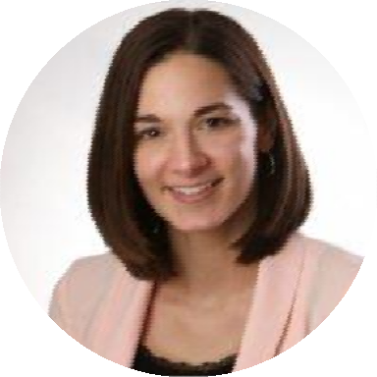
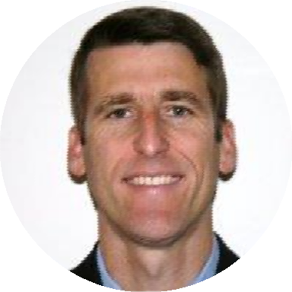
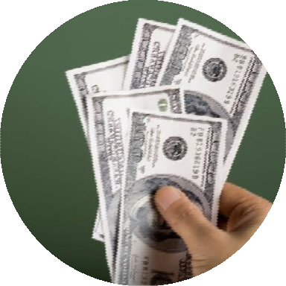


Sales
Marketing

Slide 25
Think about how your marketing and sales teams are organized and rewarded.
Is everyone awarded based on the same goal?

Slide 26
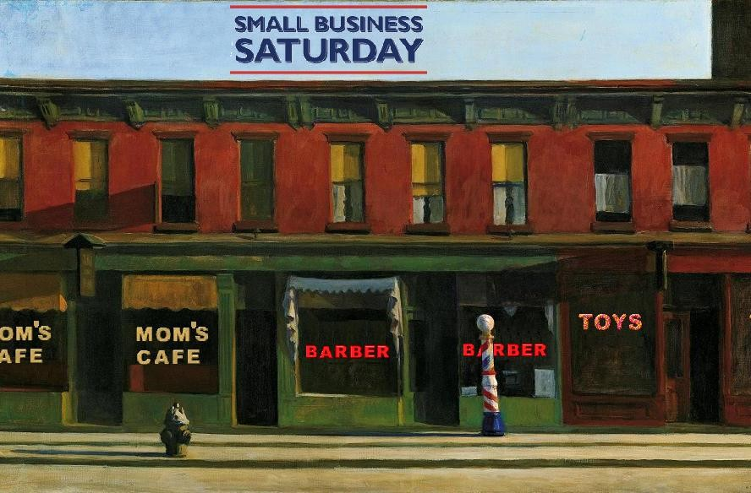

Smarketing can happen within any organization size.

Slide 27
SMARKETING BEST PRACTICES
Both teams must have the same/interdependent organizational goals.
The marketing pipeline should be tied to sales quotas.
Visibility into each other’s goals.
Compensation based on shared marketing and sales goals.
Continual communication and education around personas.

Slide 28
BOTH TEAMS MUST SHARE THE
SAME FOR SMARKETING TO BE EFFECTIVE?
Manager
Organizational goals
Office
Commission check

Slide 29
BOTH TEAMS MUST SHARE THE
SAME FOR SMARKETING TO BE EFFECTIVE?
Manager
Organizational goals
Office
Commission check

Slide 30
BOTH TEAMS MUST SHARE THE
SAME FOR SMARKETING TO BE EFFECTIVE?
Manager
Organizational goals
Office
Commission check

Slide 31
BOTH TEAMS MUST SHARE THE
SAME FOR SMARKETING TO BE EFFECTIVE?
Manager
Organizational goals
Office
Commission check

Slide 32
3
HOW DO YOU INTEGRATE SMARKETING INTO YOUR ORGANIZATION?

Slide 33
5 STEPS TO INTEGRATE SMARKETING
Speak the same language.
Implement a service level agreement.
Set up closed-loop reporting.
Rely on data.
Maintain open communication.

Slide 34
5 STEPS TO INTEGRATE SMARKETING
Speak the same language.
Implement a service level agreement.
Set up closed-loop reporting.
Rely on data.
Maintain open communication.

Slide 35

MARKETING & SALES FUNNEL

Slide 36

MARKETING & SALES FUNNEL
Top of the funnel Marketing's responsibility

Slide 37

MARKETING & SALES FUNNEL
Bottom of the funnel
Sales’s responsibility

Slide 38

MARKETING & SALES FUNNEL
Middle of
the funnel
Shared marketing & sales responsibility

Slide 39

MARKETING & SALES FUNNEL
Top of the funnel Marketing's responsibility
Middle of the funnel
Shared marketing &
sales responsibility
Bottom of the funnel
Sales’s responsibility

Slide 40

MARKETING & SALES FUNNEL
Defining the 6 stages of the marketing and sales funnel.
Contact
The most generic term
Contact
Contact
Contact Contact Contact
for anyone in a marketing and sales funnel is a contact.
The term contact doesn’t indicate which stage of the funnel they are in, just simply that they exist in the funnel.

Slide 41


MARKETING & SALES FUNNEL
Defining the 6 stages of the marketing and sales funnel.
Prospect/Visitor
Top of
the funnel
Marketing's responsibility
Prospect:
Prospects are website visitors who you’ve gathered minimal data on or who have signed up for a blog or an email newsletter.
Middle of the funnel
Shared marketing & sales
responsibility
Bottom of the funnel
Sales’s responsibility

Slide 42
MARKETING & SALES FUNNEL
Defining the 6 stages of the marketing and sales funnel.
Prospect/Visitor
Lead
Top of
the funnel
Marketing's responsibility
Lead:
When you use the term ‘lead’ you’re referring to a contact who has submitted a form in return for a content offer like an eBook, whitepaper, etc.
Middle of the funnel
Shared marketing & sales
responsibility
Bottom of the funnel
Sales’s responsibility

Slide 43
MARKETING & SALES FUNNEL
Defining the 6 stages of the marketing and sales funnel.
Prospect/Visitor
Top of
the funnel
Marketing's responsibility
Lead
MQL
Marketing Qualified Lead (MQL):
Contacts who have raised their hands (metaphorically speaking) and identified themselves as more deeply engaged,
sales-ready leads.
Middle of the funnel
Shared marketing & sales
responsibility
Bottom of the funnel
Sales’s responsibility

Slide 44
MARKETING & SALES FUNNEL
Defining the 6 stages of the marketing and sales funnel.
Prospect/Visitor
Lead
MQL SQL
Top of
the funnel
Marketing's responsibility
Sales
Qualified Lead (SQL):
SQLs are MQLs that your sales team has determined to be worthy of a direct follow-up.
Middle of the funnel
Shared marketing & sales
responsibility
Bottom of the funnel
Sales’s responsibility

Slide 45
MARKETING & SALES FUNNEL
Defining the 6 stages of the marketing and sales funnel.
Prospect/Visitor
Lead
Top of
the funnel
Marketing's responsibility
Opportunity:
An opportunity is an SQL that a sales rep has communicated with and logged as a legitimate, potential customer.
MQL
Middle of the funnel
Shared marketing & sales
responsibility
SQL
Opportunity
Bottom of the funnel
Sales’s responsibility

Slide 46
MARKETING & SALES FUNNEL
Defining the 6 stages of the marketing and sales funnel.
Prospect/Visitor
Lead
Top of
the funnel
Marketing's responsibility
MQL
Middle of the funnel
Shared marketing & sales
responsibility
SQL
Opportunity
Bottom of the funnel
Sales’s responsibility
Customer

Slide 47
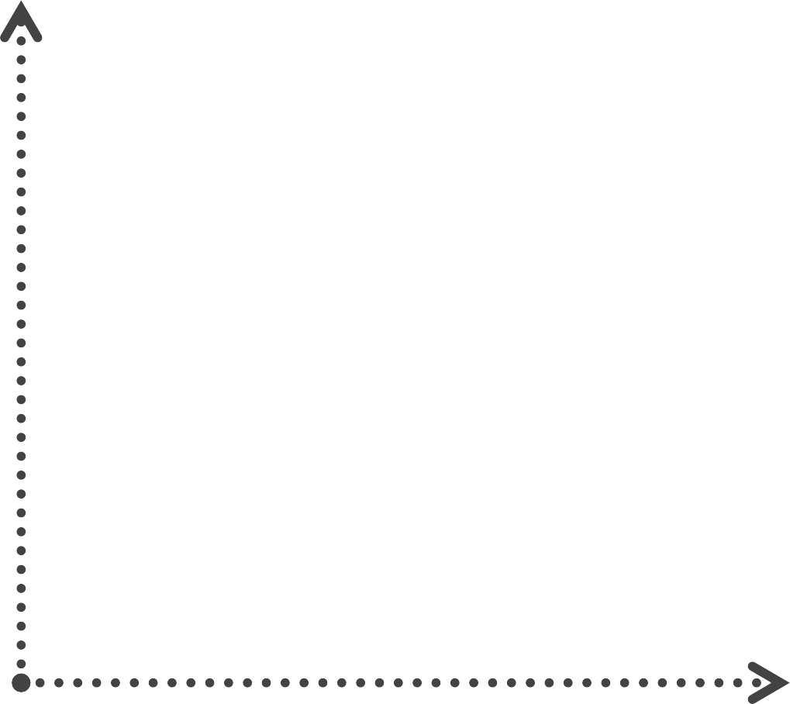
What constitutes a marketing qualified lead?
FIT
A great fit lead with high level of interest.
INTEREST

Slide 48
What constitutes a marketing qualified lead?
Avoid
FIT
A great fit lead with high level of interest.
INTEREST

Slide 49
What constitutes a marketing qualified lead?
Nurture Interest
Avoid
FIT
A great fit lead with high level of interest.
INTEREST

Slide 50
What constitutes a marketing qualified lead?
Nurture Interest
Avoid | Take Orders
FIT
A great fit lead with high level of interest.
INTEREST

Slide 51
What constitutes a marketing qualified lead?
Nurture Interest | Follow-up In 24 hours
Avoid | Take Orders
FIT
A great fit lead with high level of interest.
INTEREST

Slide 52
Sales reps that follow up with new contacts are
60x
more likely to qualify a lead than sales reps who wait 24 hours or longer.
SOURCE: HARVAND BUSINESS REVIEW, 2011

Slide 53
EXAMPLES OF
MARKETING QUALIFIED LEADS
Contact who downloaded an eBook on lead generation, company
is 200,000 employees and in North America.
A contact at a company whose role makes him/her a
decision maker, e.g. a VP or Director.

Slide 54
Only
45%
of businesses have established a company-wide
definition of a sales-ready lead.
2009 SURVEY BY MARKETINGSHERPA, HTTP://BIT.LY/ZL3SF0

Slide 55


SALES
“Marketing leads are terrible quality.”
MARKETING
“Sales doesn’t work our leads.”

Slide 56

MARKETING & SALES FUNNEL
Defining the 6 stages of the marketing and sales funnel.
Prospect/Visitor Lead
MQL
SQL
Opportunity
Customer

Slide 57


MARKETING & SALES FUNNEL
Defining the 6 stages of the marketing and sales funnel.
Prospect/Visitor
Lead
MQL SQL
Owned by
Marketing
Owned by Sales
Opportunity
Customer

Slide 58
5 STEPS TO INTEGRATE SMARKETING
Speak the same language.
Implement a service level agreement.
Set up closed-loop reporting.
Rely on data.
Maintain open communication.

Slide 59
DEFINITION OF A
SERVICE LEVEL AGREEMENT.
A Sales-Marketing SLA defines what each team commits to accomplishing in order to support the other in reaching the shared revenue goal(s).

Slide 60
An SLA crystalizes
the alignment around goals.

Slide 61


SLAs GO BOTH WAYS
MARKETING 🡪 SALES
Number and quality of leads required to hit company revenue goals.
SALES 🡪 MARKETING
Speed and depth of lead follow-up that makes economic sense.

Slide 62
CALCULATING THE SLA
MARKETING 🡪 SALES
How many leads of a certain quality does a sales rep need to make quota?
Quota (revenue) / avg. revenue per customer = # customers needed
Customers / avg. lead to customer close % = # leads needed
May vary by type (quality) of lead

Slide 63
CALCULATING THE SLA
SALES 🡪 MARKETING
How many call/email attempts to engage should a sales rep make to every lead to not waste leads?
With X leads and Y hours/month, how many follow-up attempts should a
sales rep be able to complete per lead?

Slide 64
EXAMPLE SLAs
Marketing will deliver 100 leads per sales representative, per month.
Sales will make 1 attempt to engage in 4 business hours, with 5 attempts in 14 days.

Slide 65
Determine the marketing and sales numbers
This is necessary for developing a useful Service Level Agreement (SLA)
Funnel Stage | Quantity
Prospects/Visitors | 3200
Leads | 1600
MQLs | 800
SQLs | 400
Opportunities Customers | 200 100
Revenue Goal
Shared Revenue Goal | $100,000
Average Deal Size | ÷ $1000
Customers | 100
In this example:
Timeframe: 1 year
Conversion rate between stages: 50%

Slide 66
Determine the marketing and sales numbers
This is necessary for developing a useful Service Level Agreement (SLA)
Funnel Stage
Quantity
Revenue Goal
Prospects/Visitors Leads MQLs
SQLs
Shared Revenue Goal
Average Deal Size | ÷ $1000
Customers
Opportunities
In this example:
Timeframe: 1 year
Conversion rate between stages: 50%
Customers

Slide 67
Determine the marketing and sales numbers
This is necessary for developing a useful Service Level Agreement (SLA)
Funnel Stage
Quantity
Revenue Goal
Prospects/Visitors Leads MQLs
SQLs
Shared Revenue Goal | $100,000
Average Deal Size | ÷ $1000
Customers | 100
Opportunities
In this example:
Timeframe: 1 year
Conversion rate between stages: 50%
Customers
100

Slide 68
Determine the marketing and sales numbers
This is necessary for developing a useful Service Level Agreement (SLA)
Funnel Stage
Quantity
Revenue Goal
Prospects/Visitors Leads MQLs
SQLs
Shared Revenue Goal | $100,000
Average Deal Size | ÷ $1000
Customers | 100
Opportunities
200
In this example:
Timeframe: 1 year
Conversion rate between stages: 50%
Customers
100

Slide 69
Determine the marketing and sales numbers
This is necessary for developing a useful Service Level Agreement (SLA)
Funnel Stage | Quantity
Prospects/Visitors
Leads
MQLs
SQLs | 400
Opportunities | 200
Customers | 100
Revenue Goal
Shared Revenue Goal | $100,000
Average Deal Size | ÷ $1000
Customers | 100
In this example:
Timeframe: 1 year
Conversion rate between stages: 50%

Slide 70
Determine the marketing and sales numbers
This is necessary for developing a useful Service Level Agreement (SLA)
Funnel Stage | Quantity
Prospects/Visitors | 3200
Leads | 1600
MQLs | 800
SQLs | 400
Opportunities | 200
Customers | 100
Revenue Goal
Shared Revenue Goal | $100,000
Average Deal Size | ÷ $1000
Customers | 100
In this example:
Timeframe: 1 year
Conversion rate between stages: 50%

Slide 71
Develop a Sales SLA.
Use the information you gathered from your Marketing SLA to inform the agreement.
Individual Sales Rep Weekly Capacity
Sales SLA
Review | 8 | MQLs
Convert | 4 | MQLs to SQLs
Contact | 4 | SQLs
Convert |  | SQLs to Opportunities
Close |  | Customers
MQLs needed to hit target revenue
Working weeks in a year | ÷ 48
MQLs to be reviewed each week
Sales rep MQL review capacity
Sales reps needed for target revenue

Slide 72
Develop a Sales SLA.
Use the information you gathered from your Marketing SLA to inform the agreement.
Individual Sales Rep Weekly Capacity
Sales SLA
Review | 8 | MQLs
Convert | 4 | MQLs to SQLs
Contact | 4 | SQLs
Convert | 2 | SQLs to Opportunities
Close | 1-2 | Customers
MQLs needed to hit target revenue | 800
Working weeks in a year | ÷ 48
MQLs to be reviewed each week | ~ 16
Sales rep MQL review capacity | ÷ 8
Sales reps needed for target revenue | 2
Based on our revenue target, we’d need 2 sales reps, each reviewing 8 MQLs a week,
identifying 4 SQLs, and closing 1-2 opportunities into customers.

Slide 73
5 STEPS TO INTEGRATE SMARKETING
Speak the same language.
Implement a service level agreement.
Set up closed-loop reporting.
Rely on data.
Maintain open communication.

Slide 74
CLOSED-LOOP REPORTING
Completes the feedback loop between Marketing and Sales.
MARKETING
SALES

Slide 75
Questions to identify if you need to set up closed-loop reporting:
Do you send leads to sales and never hear about them again?
Do you end up creating and trying to manage duplicate leads?
Do you send leads to sales with the basic contact information, but without intelligence about what content those leads consumed?
Are you unsure of the impact their marketing efforts are having
on revenue?

Slide 76
Closed-loop reporting allows you to pass more intel and get feedback from Sales.
Benefits for Marketing
  Get up-to-date contact info and status updates
  Learn which marketing programs are working and which aren’t
  Increase Marketing ROI
Benefits for Sales
  De-duplicate leads
  Help prioritize leads
  Help make warmer calls
  Increase close rate and Sales ROI

Slide 77
SPECIFICALLY, CLOSED-LOOP REPORTING ALLOWS YOU TO:
Analyze which marketing sources (organic, social, referral, etc.) are producing
the most customers.
Use conversion assists to help you understand how each individual piece of content you create contributes to closing customers.
Provide a timeline of all of the interactions a contact took prior to becoming
an MQL or a customer.
Pass information to sales that can help aid them in connecting and engaging with contacts within the first 24 hours
Send automatic updates to your sales team when their leads revisit the website or take other key actions, to make sure to follow up at the best time.

Slide 78
5 STEPS TO INTEGRATE SMARKETING
Speak the same language.
Implement a service level agreement.
Set up closed-loop reporting.
Rely on data.
Maintain open communication.

Slide 79
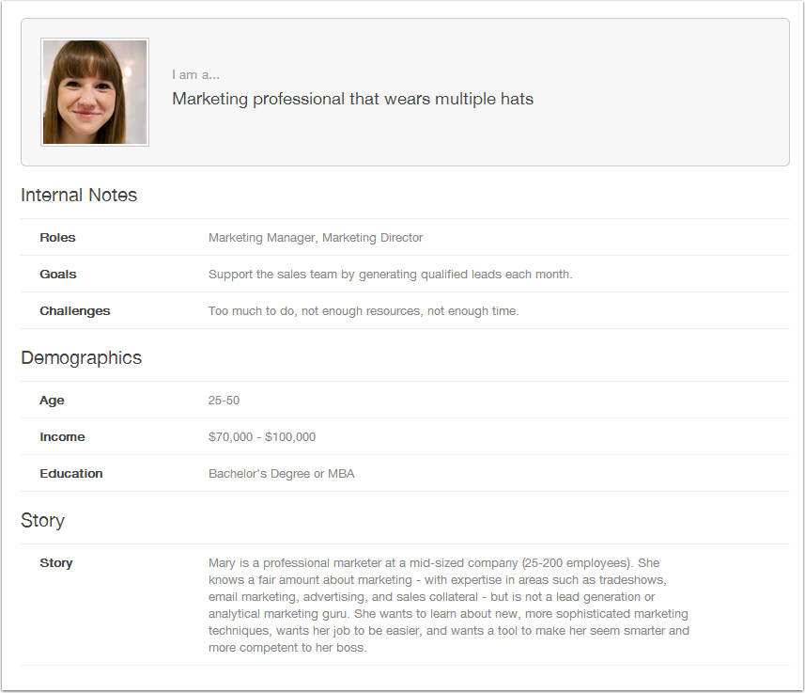
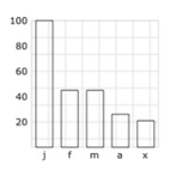
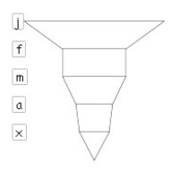

USE DASHBOARDS
Create and share a common dashboard with the reports aligned with the teams’ goals. Check the dashboard daily and encourage individuals to fix problems.
Frequent
Public
Transparent

Slide 80
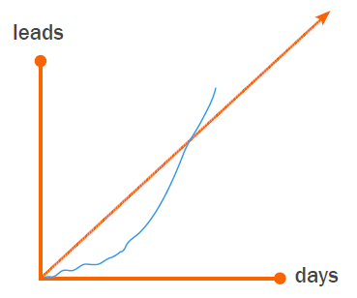
MARKETING DASHBOARDS
Measure and communicate progress towards primary goals as agreed upon in the SLA.

Slide 81
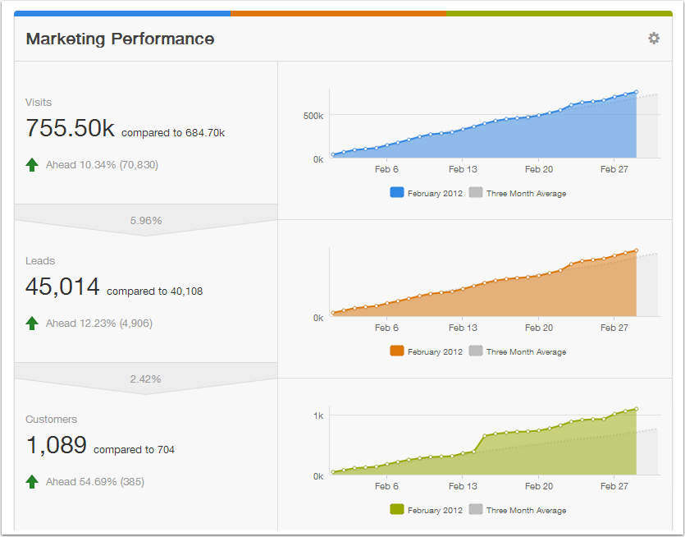
MARKETING DASHBOARDS
Measure volume of leads or volume of quality leads against the monthly goal, and check daily to adjust.

Slide 82
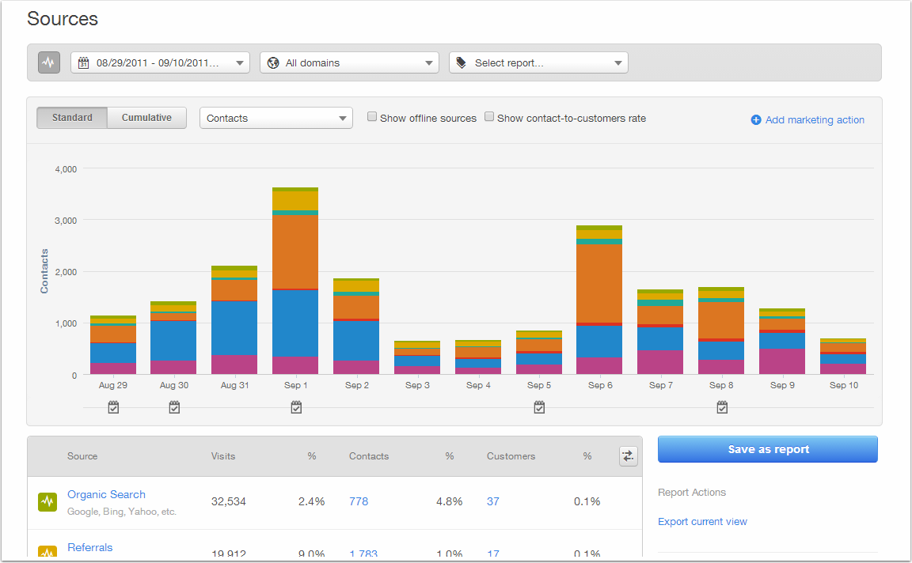
TRACK LEADS BY SOURCE
Set goals per source and measure progress for each of your efforts.

Slide 83
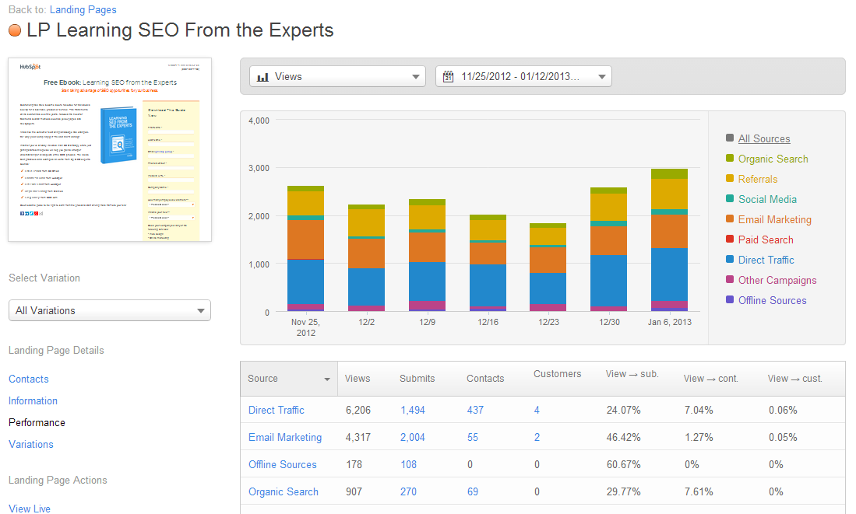
TRACK LEADS BY CAMPAIGN
Analyze the results for each campaign – which efforts successfully drive traffic, leads, and customers.

Slide 84
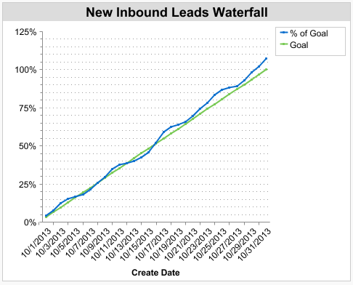
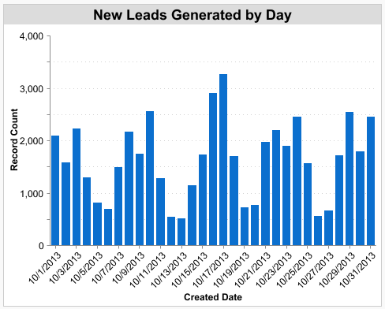
TRACK THE VOLUME OF MQLs
Measure how many MQLs – and which types – are generated.

Slide 85

MONTHLY MARKETING REPORT
Do a full analysis on a monthly basis to dig into all the important metrics and evaluate why Marketing did or did not hit targets. Share it across the company.

Slide 86
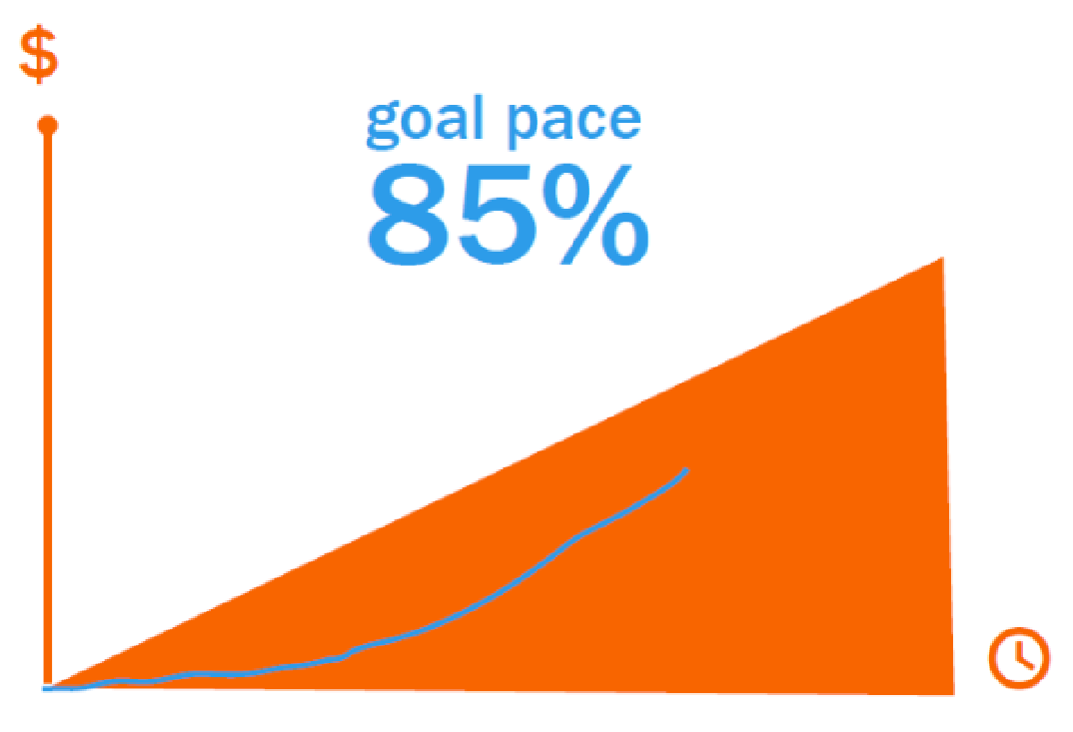
SALES BY DAY DASHBOARD
Measure progress towards the sales goal and compare against previous month.

Slide 87
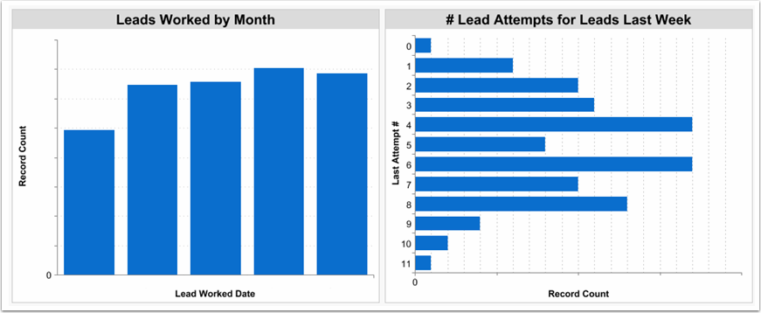
SALES ACTIVITY REPORTS
Track how many and how deeply leads are worked by the sales team.

Slide 88
What to do when things go wrong.

Slide 89




Rely on data, not emotions.
Separate reality from perception.

Slide 90
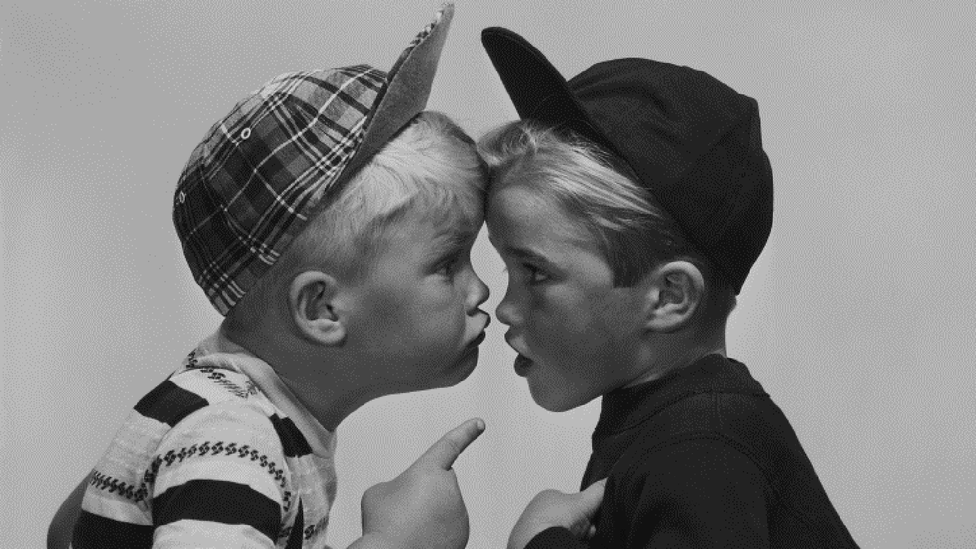

Finger pointing doesn’t solve problems
collaboration does!

Slide 91

Remember, you’re in the same boat.
Use data to figure out what’s wrong and how to fix it.

Slide 92
5 STEPS TO INTEGRATE SMARKETING
Speak the same language.
Implement a service level agreement.
Set up closed-loop reporting.
Rely on data.
Maintain open communication.

Slide 93
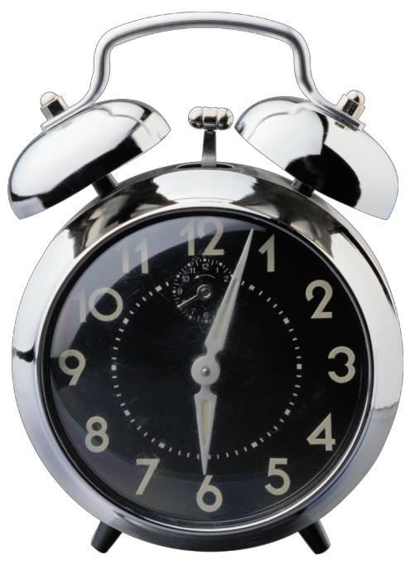
WEEKLY SMARKETING MEETING
Your entire Sales and Marketing teams attend to get on the same page about: team successes, product info, persona education, and SLA waterfalls.

Slide 94
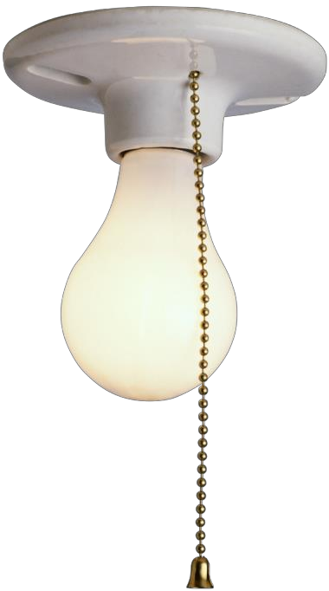
MONTHLY MANAGEMENT MEETING
Key managers attend to discuss topics in depth and resolve issues.

Slide 95
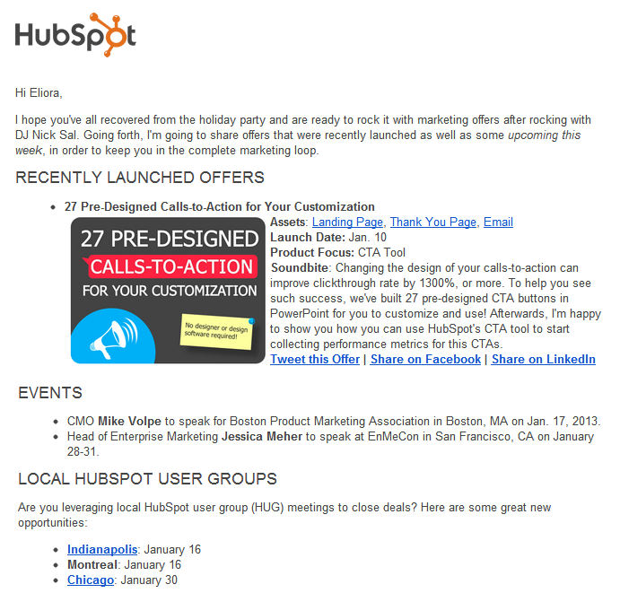
CAMPAIGN COMMUNICATION
Market your campaigns to your
sales team – share the info they need in order to be successful.

Slide 96
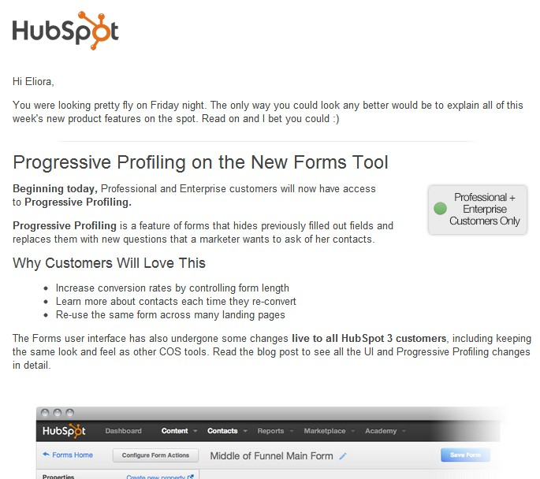
PRODUCT COMMUNICATION
Share updates about products and services – arm the sales team with the details and why customers/prospects will care.

Slide 97
5 STEPS TO INTEGRATE SMARKETING
Speak the same language.
Implement a service level agreement.
Set up closed-loop reporting.
Rely on data.
Maintain open communication.

Slide 98
THANK YOU.

